Slide 1
The Routledge Water Diplomacy Handbook
February Meeting
2022.02.08

Slide 2
Asking Questions During the Meeting
Please remain muted until we pause for questions and feedback.
The mute / unmute button can be found in the bottom left of the Zoom bar.
You may always ask a question using the chat feature, and we will address it when we pause for questions.

Slide 3
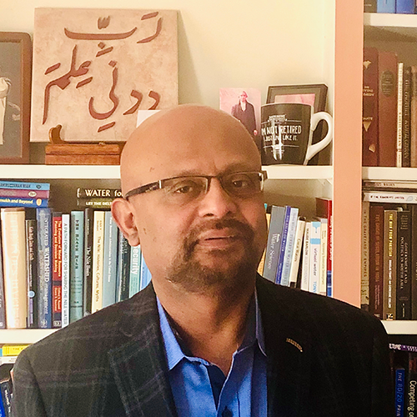
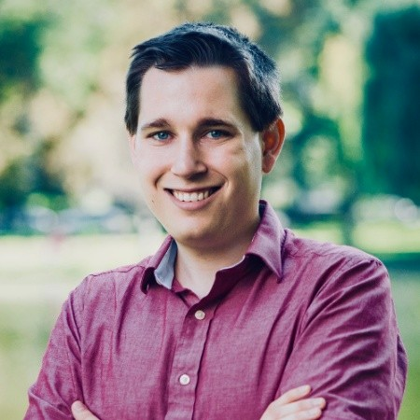
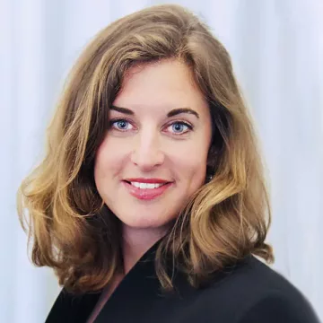
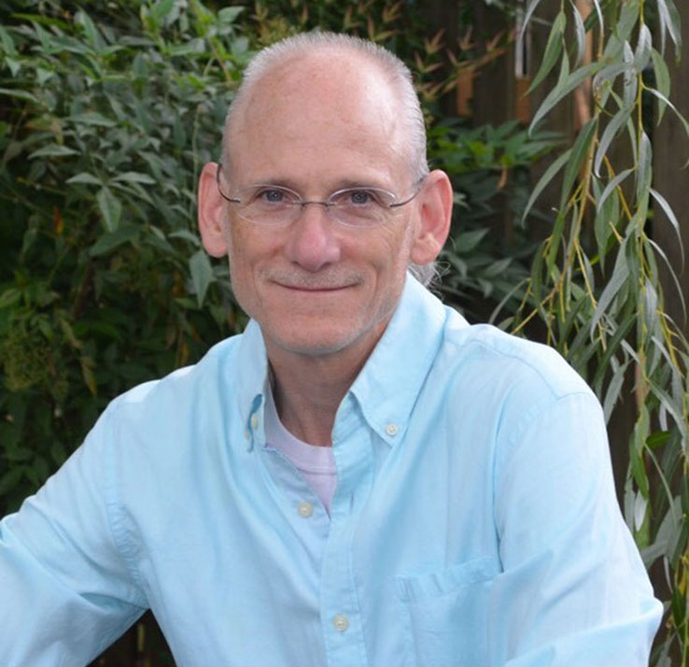
Who We Are
Dr. Shafiqul Islam
Professor of Civil and Environmental Engineering &
Director of the Water Diplomacy Program
Tufts University
Mr. Kevin Smith
PhD Candidate in Civil and Environmental Engineering &
Fellow of the Water Diplomacy Program
Tufts University
Dr. Martina Klimes
Advisor for Water and Peace
Stockholm International Water Institute and the International Centre for Water Cooperation
Dr. Aaron Salzberg
Professor of Environmental Sciences and Engineering &
Director of The Water Institute
The University of North Carolina at Chapel Hill

Slide 4
Meeting Agenda
Opening remarks
Online resources and the submission process
Answering your questions and taking your feedback
Breakout rooms for introductions and networking
Brief wrap up

Slide 5
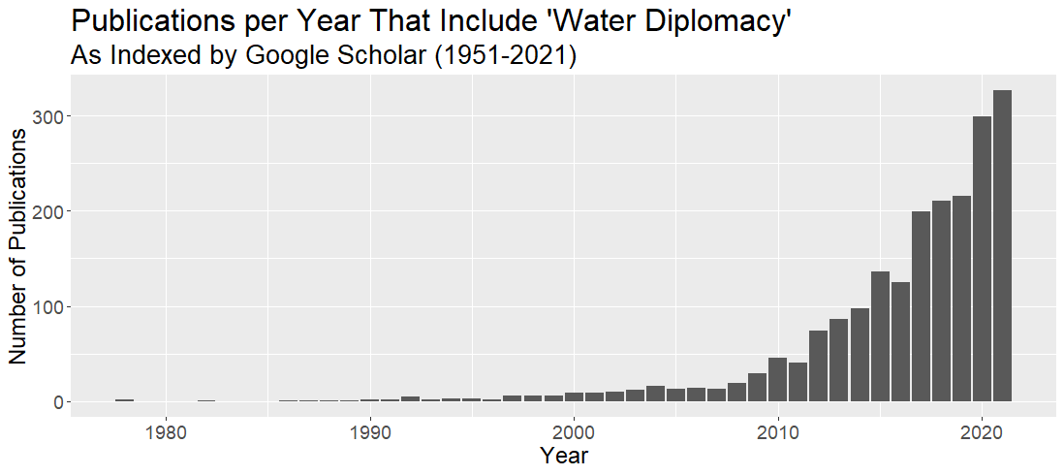

Slide 6
Our Vision for the Handbook
Create an accessible reference for those seeking negotiated resolutions to water conflicts and dialogue opportunities at the transnational, subnational, and community scale.
Many publications address these issues only at a theoretical level, and we see a compelling need for a handbook that is practice-oriented in content, structure, and its approach to theory-practice synthesis.

Slide 7
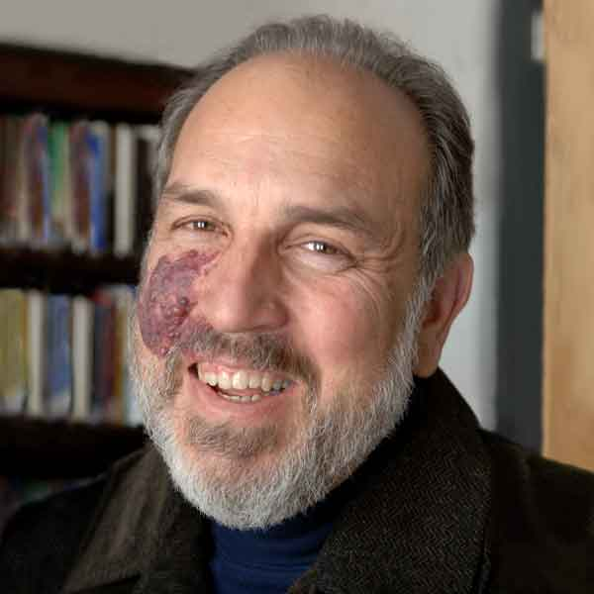
Professor Larry Susskind Urban Planning, MIT Action-Reflection-Adaptation-Public Learning A Pracademic
Over 50 years of experience and interest in
Negotiation and Dispute Resolution
Mediation and Participatory Planning in the Public Arena
Environmental Planning and Management
Water Diplomacy
https://lawrencesusskind.mit.edu/

Slide 8
Questions?
Unmute to speak…
…or ask a question using the chat feature.

Slide 9
Online Resources & The Submission Process
There are many people involved in this project – some have joined since our last meeting.
We’ve put together a website to help find important resources and information about the Handbook.
We hope this site can grow to meet our needs as an online community.
waterdiplomacyhandbook.com

Slide 10
Online Resources & The Submission Process
The website will have latest resources and information relevant to all contributors – but it is not chapter-specific.
We are using a tool called Asana to create a space for these details and provide a live view of where your chapter is in the submission process.
Asana is a shared “to-do list” – the contributors of each chapter and the editors will have a common view of deadlines, progress, and document versions.

Slide 11
Questions?
Unmute to speak…
…or ask a question using the chat feature.

Slide 12
Other Updates
We are still working on:
Negotiating Lower Book Costs
Determining Open Access Opportunities for Select Chapters
Contribution Agreements
Assigning Editors
What to expect next:
You will receive an invitation to Asana (expected week of February 14th)

Slide 13
Questions? Concerns? Feedback?
Unmute to speak…
…or ask a question using the chat feature.

Slide 14
Breakout Rooms
You will be placed randomly into breakout rooms.
There is no firm agenda – but the hope is that you will get to know some of the contributors better.
Consider sharing a bit about yourself, what chapter you are working on, and what motivated you to participate.
We will bring the groups back when there is 10 minutes left in the hour to take any final feedback from the group.

Slide 15
Closing Remarks
Thank you for joining us for this important project!
We are looking for a contributor to give opening remarks at our next meeting.
If you have ideas for topics and structures for future meetings, please let us know.
Other feedback is always welcome.

Slide 16
Questions?
Unmute to speak…
…or ask a question using the chat feature.

