Slide 1
The Routledge Water Diplomacy Handbook
April Meeting
2022.04.05

Slide 2
Asking Questions During the Meeting
Please remain muted until we pause for questions and feedback.
The mute / unmute button can be found in the bottom left of the Zoom bar.
You may always ask a question using the chat feature, and we will address it when we pause for questions.

Slide 3
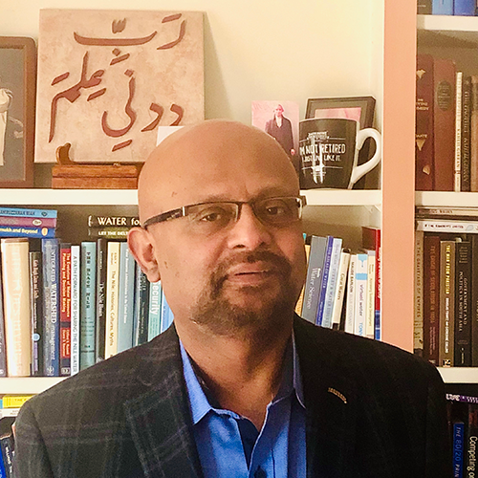
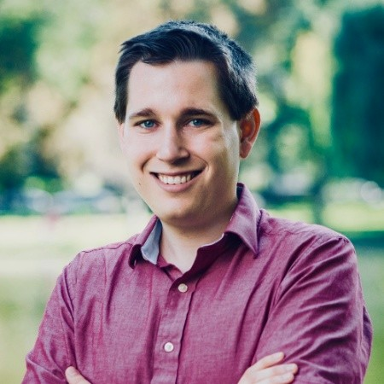
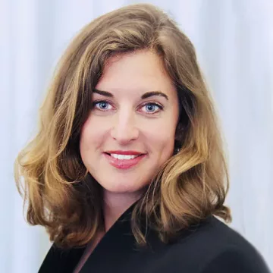
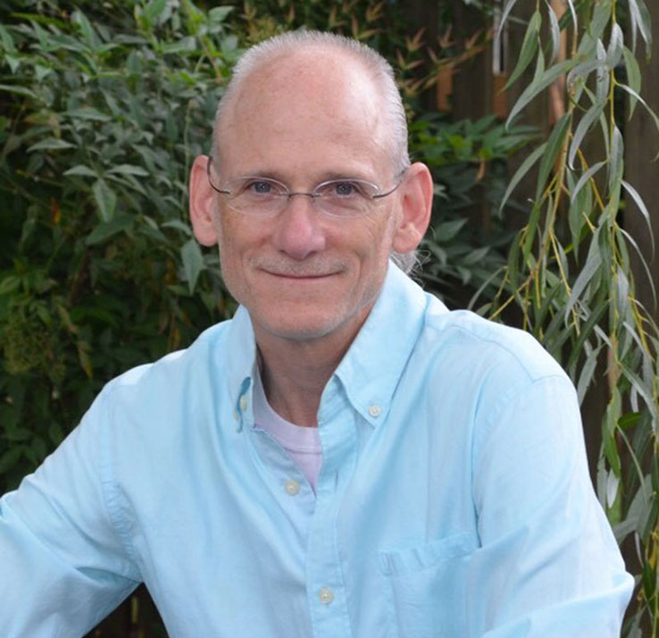
The Editors
Dr. Shafiqul Islam
Professor of Civil and Environmental Engineering &
Director of the Water Diplomacy Program
Tufts University
Mr. Kevin Smith
PhD Candidate in Civil and Environmental Engineering &
Fellow of the Water Diplomacy Program
Tufts University
Dr. Martina Klimes
Advisor for Water and Peace
Stockholm International Water Institute and the International Centre for Water Cooperation
Dr. Aaron Salzberg
Professor of Environmental Sciences and Engineering &
Director of The Water Institute
The University of North Carolina at Chapel Hill

Slide 4
Community Meetings
During the development of the Handbook, we plan to host online community meetings every two months.
We intend for these meetings to keep contributors informed of the latest Handbook developments and provide them with opportunities to network and share their work with other Handbook contributors.
We hope these conversations continue beyond the Handbook and lead to a lasting community of scholars and practitioners with a shared interest in negotiated approaches to complex water issues.

Slide 5
Meeting Agenda
Brief administrative updates
Panel discussion
Antje Herrberg – author, The Process of Water Diplomacy
Paolo Lembo – co-author, Why Diplomacy?
Saule Ospanova – co-author, Institutionalizing Progress
Breakout rooms for networking and discussion

Slide 6
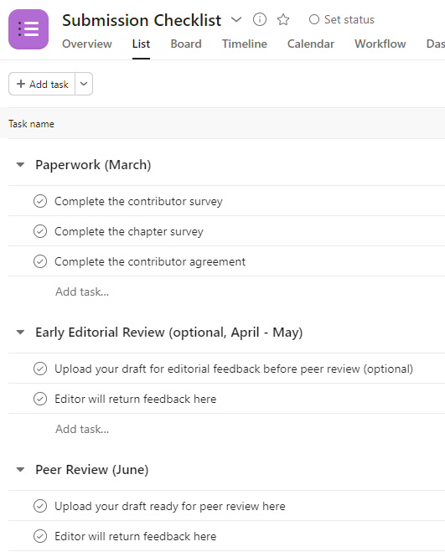
Administrative Updates - Asana
Asana invites have been sent out
Asana provides a shared to-do list for tracking the submission process
The first few tasks are paperwork related

Slide 7
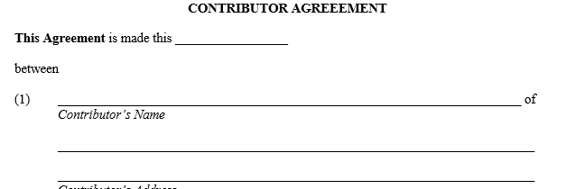
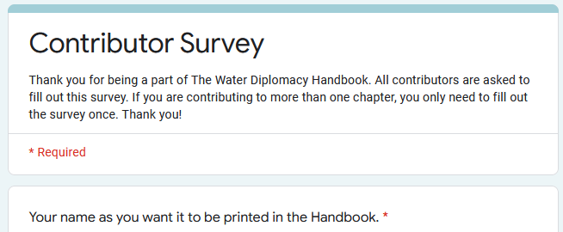
Administrative Updates – Paperwork
Contributor agreement
Outlines terms: copyright, word count, etc.
Sent via SignRequest.
Each author/co-author signs one per chapter.
Contributor survey
Gathers important information about author: full name, 1-sentence bio, address, ORCID, etc.
Each contributor completes once.
Chapter survey
Gathers important information about chapter: abstract, final title, figure requests.
Completed once per chapter.

Slide 8
Panel Discussion
Antje Herrberg – author, The Process of Water Diplomacy
Paolo Lembo – co-author, Why Diplomacy?
Saule Ospanova – co-author, Institutionalizing Progress

