Slide 1
The Routledge Water Diplomacy Handbook
August Meeting
2022.08.17

Slide 2
Our Vision for the Handbook
Create an accessible reference for those seeking negotiated resolutions to water conflicts and dialogue opportunities at the transnational, subnational, and community scale.

Slide 3
Meeting Agenda
Administrative updates
Open access
Peer review
Overview of Atlas and Glossary Projects
Breakout rooms for networking and discussion
Closing discussion / feedback

Slide 4
Open Access
We have a commitment to make the book open access under Routledge’s “gold” open access model
This means:
the book will be freely available online
you will retain the copyright to your work
the previous agreements you signed will be voided
The details still need to be worked out, but the commitment is in place.

Slide 5
Peer Review
Many chapter drafts are still in progress, so peer review is behind schedule.
The peer review process is ongoing as chapters arrive and pass an initial editorial review.
Based on responses regarding availability from reviewers, feedback may not be available until mid to late September for chapters already under review.

Slide 6
Questions?
Unmute to speak…
…or ask a question using the chat feature.

Slide 7
Atlas and Glossary Projects
Two initiatives based on ideas raised in prior community meetings.
Atlas – a new initiative based on recommendations at the last meeting. Needs basic input on goals, format, etc.
Glossary – an ongoing initiative. Needs feedback on candidate words, format, etc.
We’d like to get your feedback on how to make these additions to the handbook as useful as possible given the time and space we have.

Slide 8
Why add an atlas? We’ve heard a few ideas…
To save space. Many of our chapters are short. It would be nice to reference background material on an entity or conflict (e.g., the Silala) that is mentioned several times throughout the book but is not featured in a case study.
To provide a common place for maps. Maps used in figures throughout the book may conflict with each other re: boundaries. Providing a common reference – potentially highlighting these conflicting boundaries – could be clarifying for the reader.
Provide a standalone visualization of water conflict and cooperation across the globe. Create a collection of maps that highlights major areas of cooperation and conflict, as well as regions with easily identifiable exacerbating issues (water quality, scarcity, flooding, etc.).

Slide 9
What’s feasible? What’s useful?
We have three contributors who have expressed interest in working on the atlas.
We have limited mapping and GIS resources but could probably create a few high-quality maps.
We are starting this atlas quite late in the scope of the book.
Based on these limitations, what is a feasible path forward for the atlas that will be useful to readers?

Slide 10
Atlas - Some Questions to Consider
What do you see as the greatest benefit the atlas could provide to our readers?
Should the atlas be strictly for objective information (e.g., uncontested data, boundaries, etc.), or should it also include analysis and commentary?
Is it better to provide detail on a small number of places (mentioned frequently in the book) or roughly highlight many places (even some that may not be mentioned in the book)?
What elements are essential to an atlas entry – and which are simply nice to have? (maps, timelines, climate data, info on recurring water issues, etc.)
Should the atlas contents be linked to the “common challenges” and “tools” of water diplomacy identified in parts V and VI of the book?

Slide 11
Glossary
We will have 90+ contributors to this Handbook.
Our contributors span academia to practice in water, law, diplomacy, anthropology, etc.
Even within disciplines we have trouble agreeing on what is meant by often-used, but important phrases.
No matter what we do, readers will be confronted with divergent usages of key phrases. How can we help them navigate this issue?
The glossary is an attempt to help readers navigate key phrases used throughout the book, not by giving them a singular definition, but by clarifying and contrasting their use in a particular context.

Slide 12
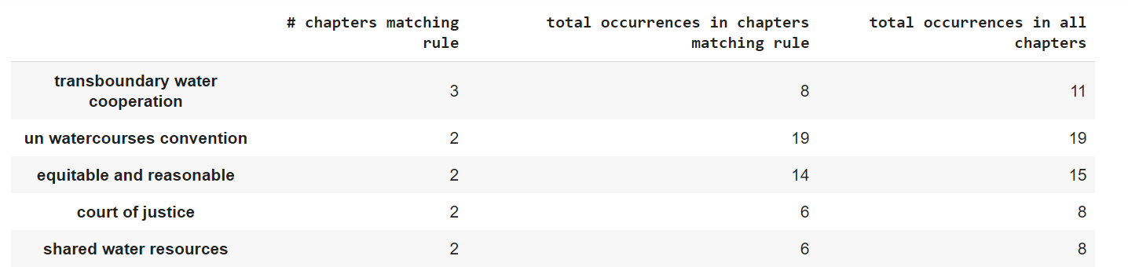
Glossary – Term Selection Process
Exploration of terms with repeated occurrences in chapters
e.g., find 3-word phrases that occur at least twice in two chapters
Quick read through of all chapters to identify possible terms
Compare term usage throughout the chapters to decide its suitability for the glossary

Slide 13
Glossary – Sample List of Terms
Equitable and reasonable
Water allocation
Right to water
Governance
Transboundary
Stakeholder participation
Joint fact-finding
Uncertainty
Fairness
Managing the commons
Adaptive processes
Fragmentation
Conflict resolution
Power Relations
Complexity
Values
Harm

Slide 14
Example Entry – Equitable and Reasonable
The term ‘equitable and reasonable’ is used in the handbook primarily to refer to a legal principle found in Article 5 of the UN Watercourses Convention. In the context of international water diplomacy, this principle can be used to guide allocation and appropriation mechanisms, as well as to ensure an adherence to baseline human rights. It also structures the process by which parties evaluate the status of water sharing agreements.
Although it is used in the Convention, the term ‘equitable and reasonable’ is vaguely defined and open to interpretation. In Chapter 39, Campbell-Ferrari and Wilson elaborate on this ambiguity and its implications in the UN Watercourses Convention. Evaluations of whether agreements are ‘equitable and reasonable’ are decided on context and can be different on case-to-case basis. For water negotiations to be effective, parties must come to an understanding of what is deemed ‘reasonable’ and ‘equitable’ in a given context. Examples of challenges surrounding the lack of clear definition of ‘equitable and reasonable’ and the use of the phrase can be found in chapters 25,47, and 49, which detail specific cases for the Silala River, the Helmand River, and the Sava River, respectively (Spijkers; Faizee; Komatina).
In addition to the legal definition, the terms ‘reasonable’ and ‘equitable’ are used in their generic sense throughout the Handbook, without explicit to reference to Article 5.

Slide 15
Glossary - Some Questions to Consider
What terms would you like to see / not see in the glossary?
How should bigger terms like ‘water diplomacy’ be included in the glossary, if at all?
What format would you like to see glossary entries in?
Paragraph form with overview of the uses (like previous example)
Paragraph with each chapter’s use explicitly shown (i.e.,: chapter 1 defines ‘equitable and reasonable’ as…, chapter 5 defines ‘equitable and reasonable’ as…
Other?

Slide 16
Remaining Schedule
Breakout Rooms for Atlas and Glossary Discussion
Screen will display atlas questions for first half of discussion
Screen will display glossary questions for second half
Closing Discussion
Follow-up: There will be a survey emailed around where you can provide more detailed feedback on the Atlas and Glossary.
World Water Week – Email us to let us know if you’d like to meet.

