Slide 1

The Routledge
Water Diplomacy Handbook
October Community Gathering
2022.10.10

Slide 2
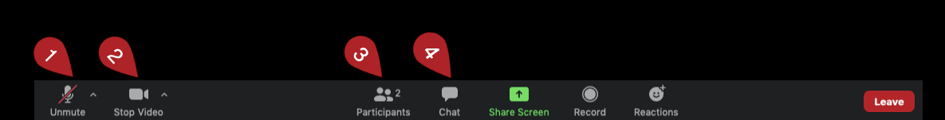
Asking Questions During the Meeting
  Please remain muted until we pause for questions and feedback.
  The mute / unmute button can be found in the bottom left of the Zoom bar.
  You may always ask a question using the chat feature, and we will address it when we pause for questions.

Slide 3
Agenda
Brief administrative updates.
Larry Susskind and Shafiqul Islam reflect on “10 years of learning by doing” since they published their first book and article on Water Diplomacy.
Q&A / Discussion

Slide 4
Our Vision for the Handbook
Create an accessible reference for those seeking negotiated resolutions to water conflicts and dialogue opportunities at the transnational, subnational, and community scale.

Slide 5
Administrative Updates
Editorial review and peer review is ongoing
  Thank you to the reviewers for their diligence and to the authors for their patience!
Open access
  We are in ongoing conversations with the group who has committed funding for open access regarding logistics, review, etc. We may need to share some of your unfinished drafts as part of this process. Let us know if you have any concerns.
Asana
  No longer using – didn’t work out. We’ll use email instead.

Slide 6
Questions?
  Unmute to speak…
  …or ask a question using the chat feature.

Slide 7
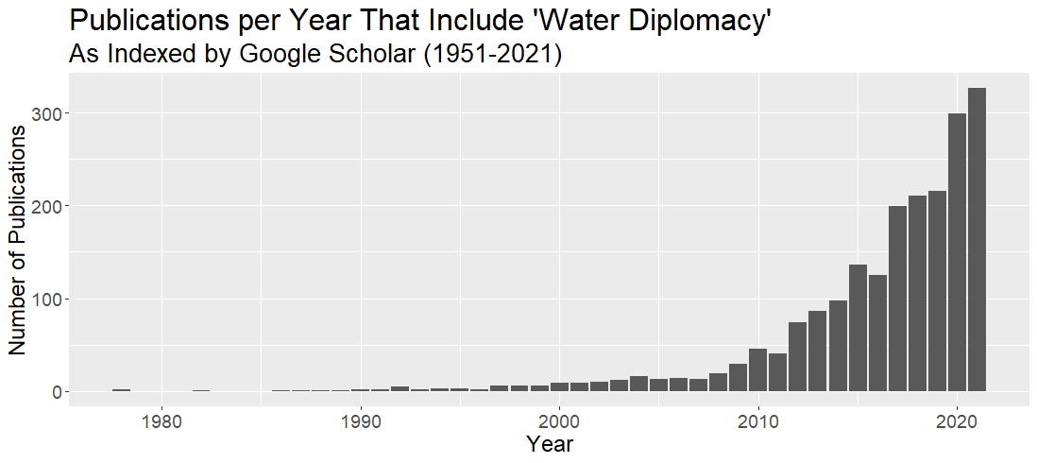

Larry and Shafik’s First Water Diplomacy Book

